Slide 1
Cloud PBX: Real world scenarios
Ralph Eckhard

Slide 2

Ralph Eckhard
IT Architect @ PeopleWare ICT
Modern Workplace / M365
www.365dude.nl
@ralpje

Slide 3
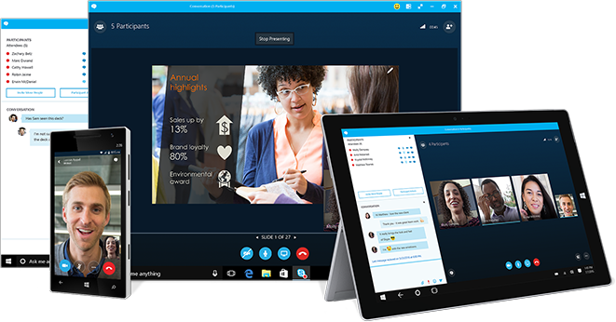
Elements of Skype for Business Online
Skype for Business (E1,E3,E5)
Instant messaging and presence
VoIP voice and video (w/o phone numbers)
Online Conferencing
Cloud PBX feature (add-on,E5)
Common calling features
PSTN Conferencing (add-on,E5)
Dial-in and dial-out for meetings
PSTN Connectivity / Calling (add-on)
Local, long distance and international
Notes:
Basic overview of SfB services in O365. Note that PSTN is always an add-on. Next slide for table version.

Slide 4
Office 365 Enterprise suites | E1 | E3 | E5
Skype for Business (IM, Meetings, etc.) | ■ | ■ | ■
Office Client Apps |  | ■ | ■
PSTN Conferencing (dial-in phone numbers) | Add-on | Add-on | ■
Cloud PBX (Phone system in the cloud) | Add-on | Add-on | ■
PSTN Calling (user phone numbers) | Add-on | Add-on | Add-on
Communication credits | Add-on | Add-on | Add-on
Notes:
Cloud PBX: phone system
Conferencing: no cloud pbx needed for this. Dial-in and dial-out (local to country without per-minute charges)
Calling: User numbers. Always an add-on. Can’t get user phone numbers without this license.
Communication credits are for calling charges not covered by PSTN calling plan.

Slide 5
Cloud PBX – Global availability
Office 365 Online meetings & broadcast Cloud PBX | Worldwide
PSTN Conferencing | Local dial-in numbers in 90+ countries
Microsoft PSTN Calling | US, UK, Puerto Rico, France, Spain, Netherlands, Ireland, Germany, Canada, Belgium. Australia in preview
Bring you own PSTN (hybrid) | Worldwide using cloud connectivity
Notes:
PSTN conf: local numbers in 90+ countries. Not all countries can sell this, depens on tenant location.
PSTN calling: limited availability due to country regulations. Constantly increasing.
BYO PSTN: cloud connector edition.

Slide 6
PSTN Conferencing
Enable a phone to join a SfB Meeting
Phone user can dial into a meeting
Conference joiners can have client ‘dail their regular phone’ for audio
Users in the conference can dial out to phone users
You don’t need Enterprise Voice or Cloud PBX

Slide 7
Demo: PSTN Conferencing
Notes:
Demo of conferencing setup for user and meeting info.

Slide 8
Cloud PBX

Slide 9
3 Options for connectivity
Microsft PSTN Calling
MS is your carrier
Bring your own carrier / on-prem PSTN
Skype for Business server (hybrid)
Cloud Connector Edition (dedicated server / appliance)
Notes:
1 option for full cloud: PSTN Calling.
2 options for BYO: SfB on-prem or CCE

Slide 10
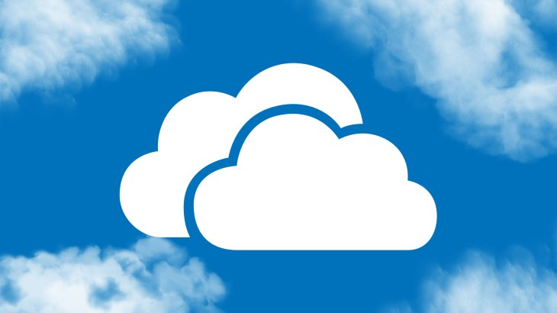




Deployment options
Registrar / conferencing bridge
API
Internet
Express route
Edge web & media services
Cloud voicemail
Mediation and gateway
Notes:
Full cloud deployment: only thing on prem is the user. Everything else hosted in the cloud.

Slide 11

Deployment options
Registrar / conferencing bridge
API
Registrar / conferencing bridge
Trusted apps
Internet
Express route
Edge web & media services
Edge web & media services
Cloud voicemail
Mediation and gateway
Mediation and gateway
Notes:
Next: bring in some on-prem infra: full hybrid.

Slide 12


Deployment options
Registrar / conferencing bridge
API
Registrar / conferencing bridge
Trusted apps
Internet
Express route
Edge web & media services
Edge web & media services
Cloud voicemail
Mediation and gateway
Mediation and gateway
Notes:
3 types of users: full cloud.
1 – Hybrid user. Homed on O365 but gets PSTN through SfB server
2 – Full cloud: like 1st slide
3 – Full on-prem.
You can move users from on-prem to O365 and eventually decommission SfB on-prem.

Slide 13
Deployment options
Registrar / conferencing bridge
API
Internet
Express route
Edge web & media services
Cloud connector edition
Cloud voicemail
Mediation and gateway
Notes:
Replace on-prem infra with CCE. Two types of user now:
1 – On-prem user disappears
2 – full cloud
3 – ‘hybrid’ guy. Homed in O365 but gets PSTN through CCE.
This means you can migrate from CCE to O365. Might be good scenario for countries that currently don’t have calling plan avail.
When CCE is decommissioned, move it to another country or location.

Slide 14
Cloud Connector Edition
Hyper-V VM’s on a dedicated physical server
AD, CMS, Mediation and Edge. Lives in DMZ.
Connect to carrier via SIP, SBC or IP PBX.
50 up to 500 concurrent calls
Group up to 4 for HA in a site
Up to 200 sites per deployment
Notes:
Overview of CCE
CMS = central management store

Slide 15
SfB Hybrid
SfB on-prem with Enterprise Voice. Globaly available
Can’t combine SfB server with Cloud Connector Edition
All 3rd party integrations
Move user from on-prem to Cloud PBX
More servers / licensing costs
Notes:
Overview of hybrid setup.

Slide 16
PSTN Calling
PSTN Connectivity directly by Microsoft
Simple administration
Legal requirements for local market met by Microsoft
New numbers acquisition extremely simple
Number porting to move existing numbers
Notes:
Full cloud. New number acquisition not simple when you’re in NL.

Slide 17
PSTN Calling
PSTN Connectivity directly by Microsoft
Simple administration
Legal requirements for local market met by Microsoft
New numbers acquisition extremely simple
Number porting to move existing numbers
Notes:
Full cloud. New number acquisition not simple when you’re in NL.

Slide 18
Choose your deployment
If you have SfB Server:
Cloud PBX Hybrid with PSTN coming from on-prem or PSTN Calling
If you don’t have SfB Server:
Who can you move today?
PSTN Calling: zero infra requirement
CCE is quicker and easier
Features / integration needed? Go hybrid
Notes:
Ways to choose: if you currently have SfB on-prem, only option is hybrid.
If you don’t have SFB: full cloud will be best option. For local PSTN break-out, go CCE. Of you need full API, call recording, etc., go hybrid.

Slide 19
PSTN Calling – per user plans
Addition on top of Cloud PBX
Two options:
Domestic – €10,10
Domestic and International - €20,20
Additional: communication credits
‘pre paid’ plan
Notes:
Current plans in NL.
1200 mins domestic, 600 international.

Slide 20
Demo Cloud PBX features
Notes:
Demo: create user in portal (show). Request NL number (doesn’t work). Show call queue in portal. Create AA in portal.
Powershell: create user and assign license. Request number and assign to user. Create queue and demonstrate. Show code for creating AA.

Slide 21
Call queues
Automated call distribution
Up to 50 agents and 200 calls
Service number infrastructure
Agents are distribution groups or mail enabled security groups
Calls routed in parallel, except offline and DND users
Disconnect or redirect to user, AA or call queue
Notes:
Recap of what was shown: call queue functionality. Note: need service number for this!

Slide 22

Try the call queue +31202588793

Slide 23
Auto attendant
Automation for inbound calls
Voice prompt or text-to-speech
Input with DTMF or speech recognition
Associated with a service number
Multiple routing options: search against AD or menu options
Notes:
AA: need service number!
If your hybrid, these should be 100% cloud.

Slide 24
Core user features
Call answer / initiate (by user or number)
Call hold / retrieve
Call history
Call delegation & call on behalf
Call transfer
Caller ID
Call waiting
Call forward & simultaneous ring
Clients for PC, Mac & mobile
Device switching
Distinctive ringing
DND routing & call blocking
Enterprise calendar call routing
Integrated dial pad
Music on hold
Qualified IP desk phones
Team calling
Voice mail
Notes:
Core functionality. Recap of what was shown.
Any questions?

Slide 25
Code available on Github this afternoon
feedback.expertslive.nl
Twitter: @ralpje
www.365dude.nl
Notes:
Relevant information

Slide 26
Relevant session: 14:45 – 15:45
Network considerations for Office 365 based telephony
Steven van Houttum
Notes:
If you would like to start using SfB Cloud PBX, visit this session by Steven to learn about network consideration and implications, to ensure call quality.

Slide 27
Next session: 13:30 – 14:30
How a Dutch telco got 10k+ users on Office 365
Marcel Alberts
Notes:
Next session in Office 365 track by Marcel Alberts.

